Slide 1
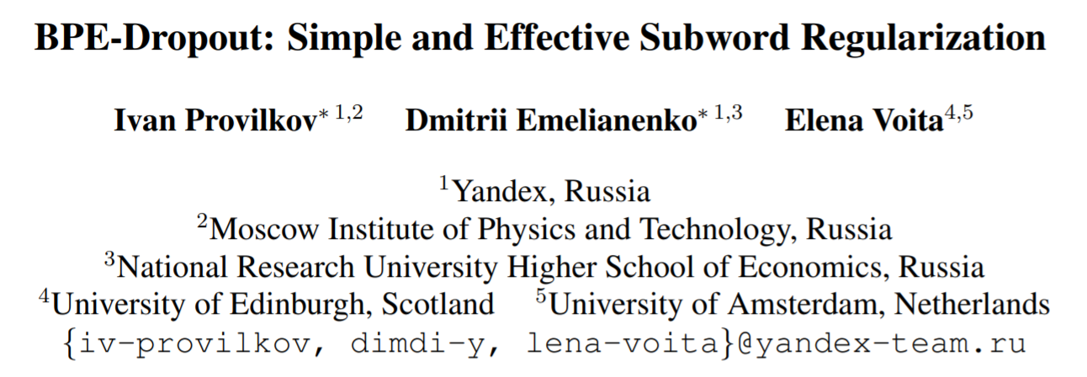
ACL 2020

Slide 2
Introduction
BPE potentially allows a model to make use of morphology, word composition and transliteration.
But it splits words into unique subword sequences, which means that for each word a model observes only one segmentation.
Thus, a model is likely not to reach its full potential in exploiting morphology, learning the compositionality of words and being robust to segmentation errors.

Slide 3
Introduction
Kudo (2018) used multiple segmentation candidates as a subword regularization, implemented as an on-the-fly data sampling.
The author proposed a new but rather complicated subword segmentation method, different from BPE.
Taku Kudo. 2018. Subword regularization: Improving neural network translation models with multiple subword candidates. In Proceedings of the 56th Annual Meeting of the Association for Computational Linguistics (Volume 1: Long Papers), pages 66–75, Melbourne, Australia. Association for Computational Linguistics.

Slide 4
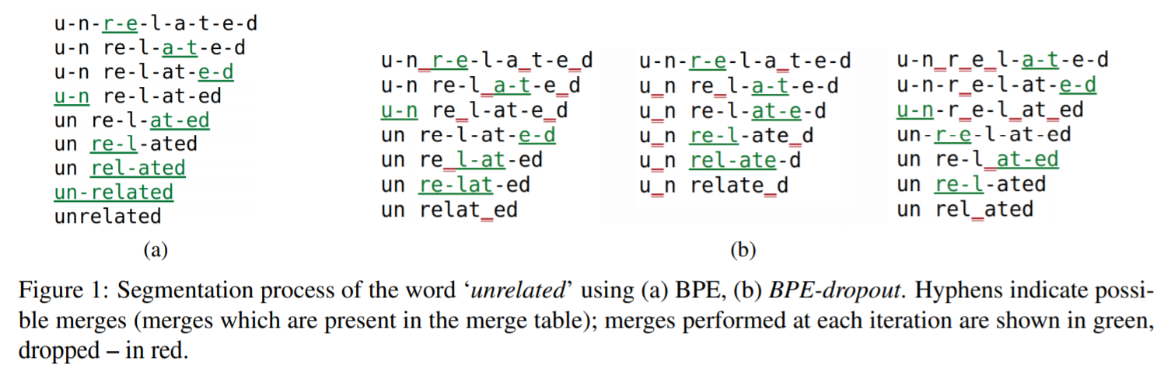
Introduction
We introduce BPE-dropout, a subword regularization method based on and compatible with conventional BPE.
It uses a vocabulary and a merge table built by BPE, but at merge step, some merges are randomly dropped.

Slide 5
Introduction
Our key contributions are as follows:
We introduce BPE-dropout – a simple and effective subword regularization method;
We show that our method outperforms both BPE and previous subword regularization on a wide range of translation tasks;
We analyze how training with BPE-dropout affects a model and show that it leads to a better quality of learned token embeddings and to a model being more robust to noisy input.

Slide 6
Background – BPE
BPE builds a token vocabulary and a merge table.
Each word is represented as a sequence of tokens + END OF WORD.
The method iteratively counts all pairs of tokens and merges the most frequent pair into a new token, which is added to the vocabulary and the merge table.
Goto step 2 unless the desired vocabulary size is reached.

Slide 7
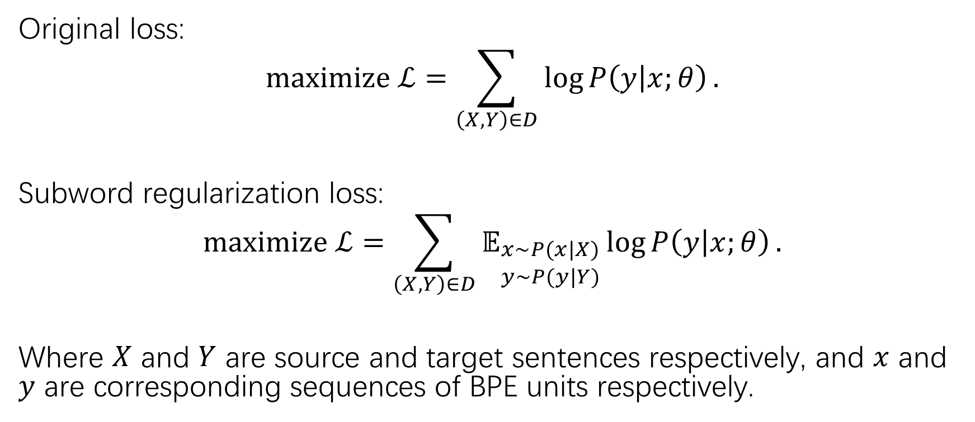
Background – Subword Regularization
Original loss:
$$maximize ℒ=\sum_{\left(X, Y\right)∈D}{\log{P\left(y | x;θ\right)}}.$$
Subword regularization loss:
$$maximize ℒ=\sum_{\left(X, Y\right)∈D}{𝔼_{\begin{aligned}x\sim P(x|X) \\ y\sim P(y|Y)\end{aligned}}\log{P\left(y | x;θ\right)}}.$$
Where $X$ and $Y$ are source and target sentences respectively, and $x$ and $y$ are corresponding sequences of BPE units respectively.

Slide 8
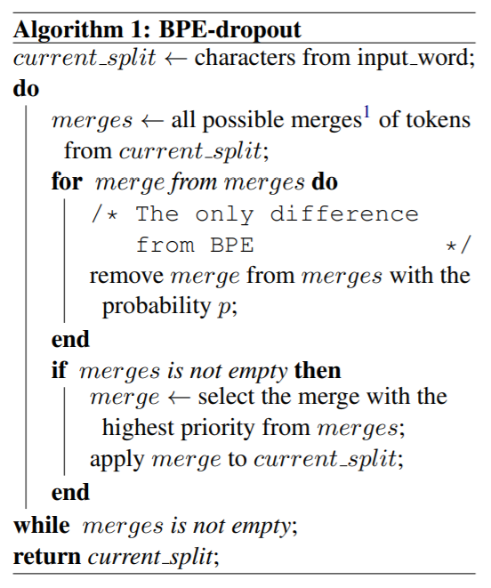
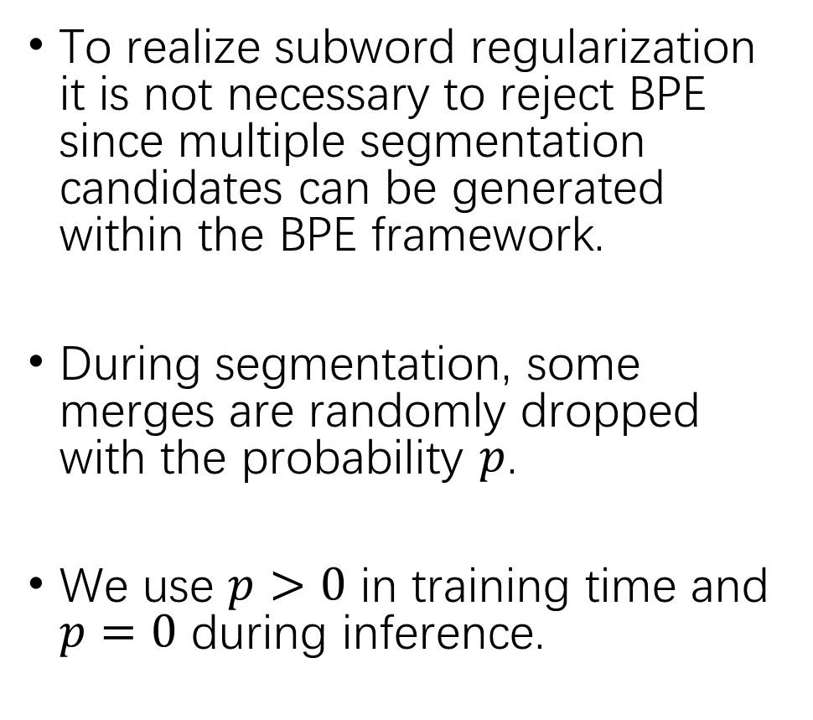
BPE-dropout
To realize subword regularization it is not necessary to reject BPE since multiple segmentation candidates can be generated within the BPE framework.
During segmentation, some merges are randomly dropped with the probability $p$.
We use $p>0$ in training time and $p=0$ during inference.

Slide 9
Experimental setup
Baseline:
Standard BPE and the subword regularization by Kudo (2018).
Vocabularies:
Two choices:
Take the vocabulary built by BPE: segmented with BPE-dropout text will cantain a small number of UNKs.
Add to the BPE vocabulary all tokens which can appear when sengmenting with BPE-dropout.
No difference observed in preliminary experiments.
We choose option 1.
To stay in the same setting as the standard BPE.
To expose the model to some UNKs in training.

Slide 10
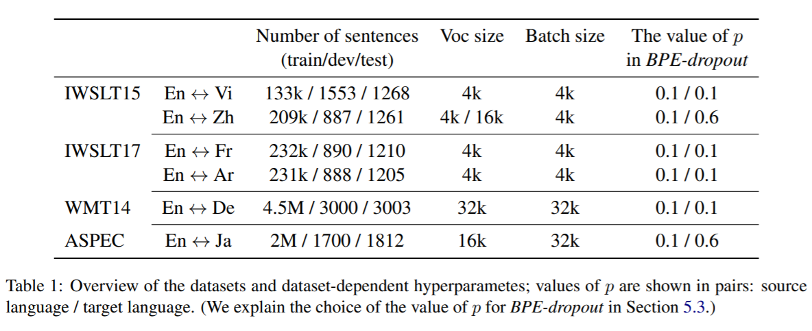
Experimental setup
Model and optimizer:
The model is Transformer base (Vaswani et al., 2017).
Regularization and optimization are the same as Vaswani et al. (2017).
Datasets:

Slide 11
Experimental setup
Training:
We train models till convergence.
Inference:
Beam search with the beam of 4 and length normalization of 0.6.
Evaluation:
We average 5 latest checkpoints and use BLEU computed via SacreBleu.
For Chinese, we add option --tok zh to SacreBleu.
For Japanese, we use character-based BLEU.

Slide 12
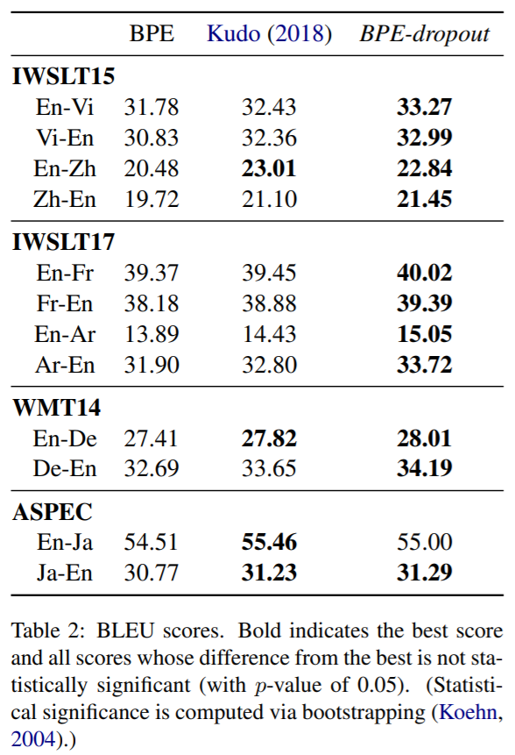
Experiments – Main results
For all datasets, BPE-dropout improves significantly over the standard BPE.
Compared to Kudo (2018), among the 12 datasets BPE-dropout is beneficial for 8 datasets, is not significantly different for 3 datasets and underperforms only on En-Ja.
The results suggest that Japanese and Chinese may benefit from a language-specific segmentation.
Kudo (2018) report larger improvements over BPE from using their method. This is maybe because Kudo (2018) used large vocabulary size, which has been shown counterproductive for small datasets.

Slide 13
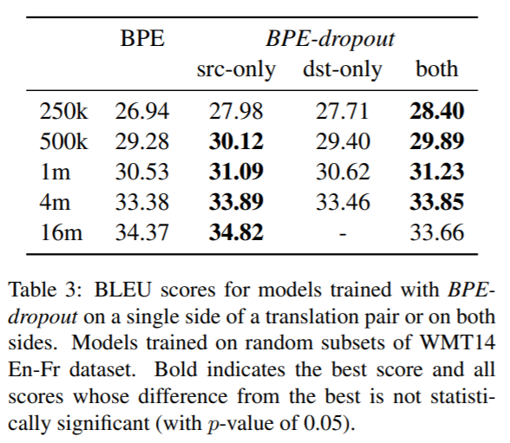
Experiments – single side vs full regularization
Random subsets of different sizes from WMT14 En-Fr data are selected to understand how the results are affected by the amount of data.
For small and medium datasets, full regularization performs best;
For large datasets, BPE-dropout should be used only on the source side.
In subsequent sections, we use BPE-dropout on both source and target side.

Slide 14
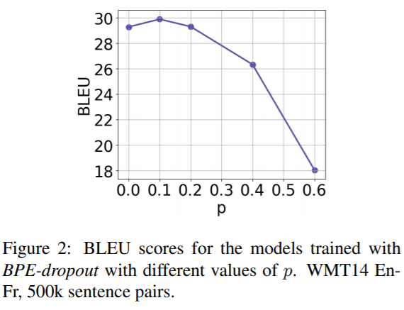

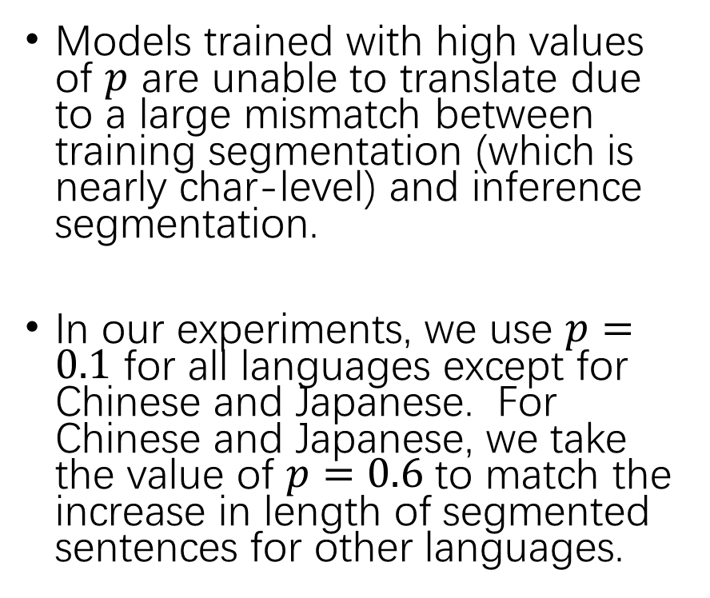
Experiments – Choices of the value of $p$
Models trained with high values of $p$ are unable to translate due to a large mismatch between training segmentation (which is nearly char-level) and inference segmentation.
In our experiments, we use $p=0.1$ for all languages except for Chinese and Japanese. For Chinese and Japanese, we take the value of $p=0.6$ to match the increase in length of segmented sentences for other languages.

Slide 15
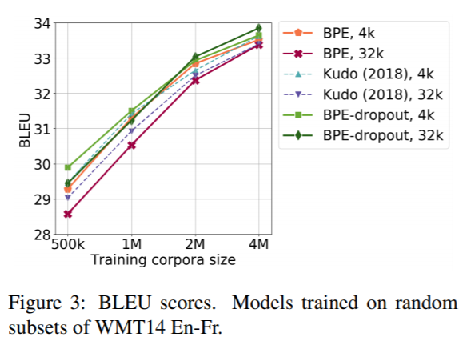
Experiments – Varying corpora and vocabulary size
BPE-dropout performs best for all dataset sizes.
Models trained with subword regularization are less sensitive to the choice of vocabulary size.
The effect from using BPE-dropout vanishes when a corpora size gets bigger. Note that when applied to noisy source, models trained with BPE-dropout show substantial improvements even on high-resource settings.

Slide 16
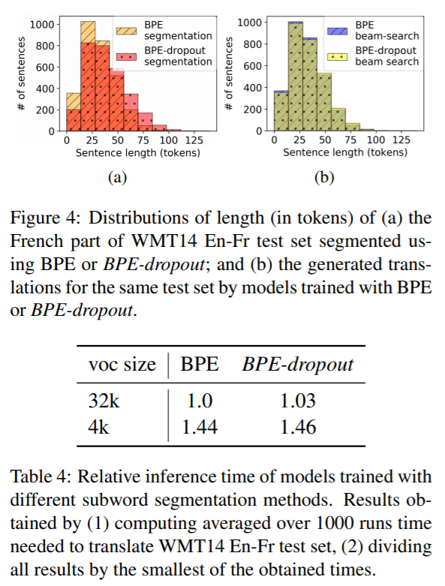
Experiments – Inference time and length of generated sequences
Sentences segmented with BPE-dropout are longer.
Models trained with BPE-dropout may tend to use more fine-grained segmentation in reference?
No, the distributions are almost the same.
The inference time of models trained with BPE-dropout is not substantially different from the ones trained with BPE.

Slide 17
Analysis
In this section we analyze qualitative differences between models trained with BPE and BPE-dropout. We find that:
when using BPE, frequent sequences of characters rarely appear in a segmented text as individual tokens rather than being a part bigger ones; BPE-dropout alleviates this issue;
using BPE-dropout leads to a better understanding of rare tokens;
as a consequence of the above, models trained with BPE-dropout are more robust to misspelled input.

Slide 18
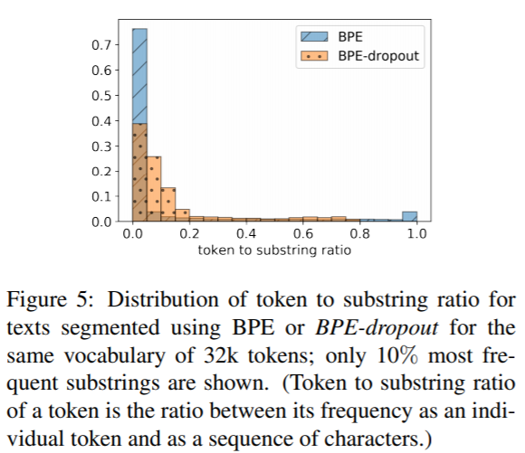
Analysis – Substring frequency
One drawback of BPE’s deterministic nature:
Only rare words are split into subwords.
Frequent sequences of characters mostly appear in a segmented text as part of bigger tokens rather than as individual tokens.
For frequent substrings, the distribution is significantly shifted away from 0, so frequent substrings appear in a segmented text as individual tokens more often.

Slide 19
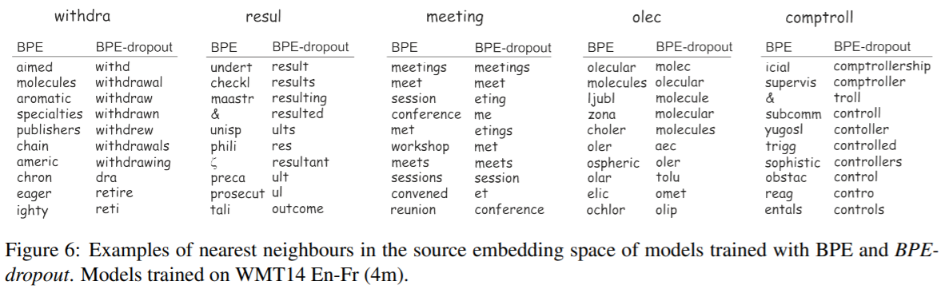
Analysis – Properties of the learned embeddings
In contrast to BPE, nearest neighbors of a token in the embedding space of BPE-dropout are often tokens that share sequences of characters with the original token.
We computed character 4-gram precision of top-10 neighbors: the proportion of those 4-grams of the top-10 closest neighbors which are present among 4-grams of the original token. Embeddings of BPE-dropout have higher character 4-gram precision (0.29) compared to the precision of BPE (0.18).

Slide 20
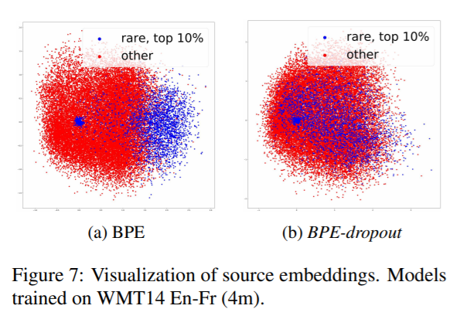
Analysis – Properties of the learned embeddings
For the model trained with BPE, rare tokens are in general separated from the rest.
For the model trained with BPE-dropout, this is not the case.

Slide 21
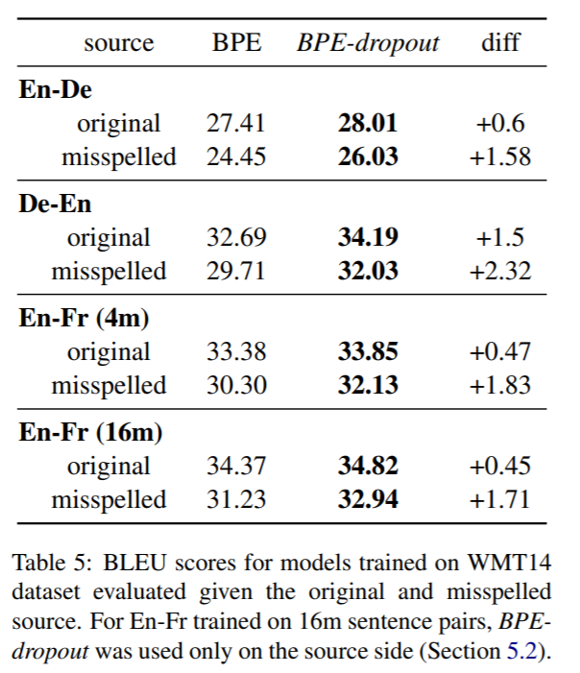
Analysis – Robustness to misspelled input
Models trained with BPE-dropout are more robust to noise, because they better learn compositionality of words and the meaning of subwords.
We verify this by measuring the translation quality of models on a test set augmented with synthetic misspellings.
We modify the source side of a test set with the probability of 10% for each word to be modified so that the edit distance is 1 between the modified word and unmodified one.
On large datasets where improvements from using BPE-dropout are small, for misspelled test set the improvements are a bit larger.
Note that models have not been exposed to misspelling during training.

Slide 22
Conclusion
Models trained with BPE-dropout
outperform BPE and the previous subword regularization on a wide range of translation tasks;
have better quality of learned embeddings;
are more robust to noisy input.
Further research directions:
Adaptive dropout rates for different merges
An in-depth analysis of other pathologies in learned token embeddings for different segmentations.

